Slide 1
Public Group Meeting (9/4/24)
Somdeepa Das

Slide 2
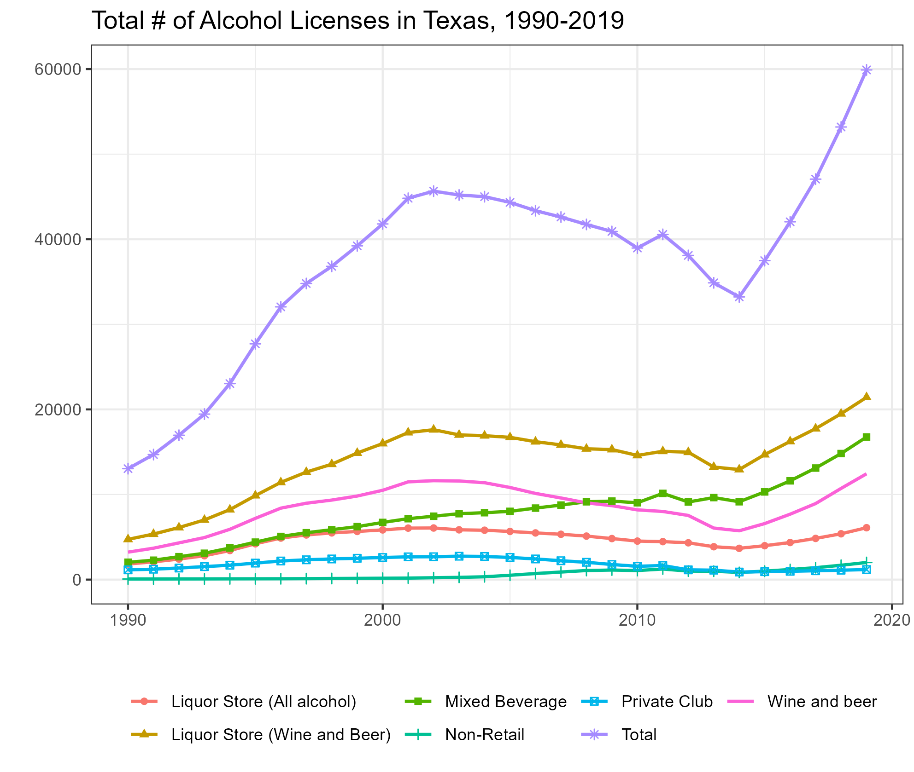
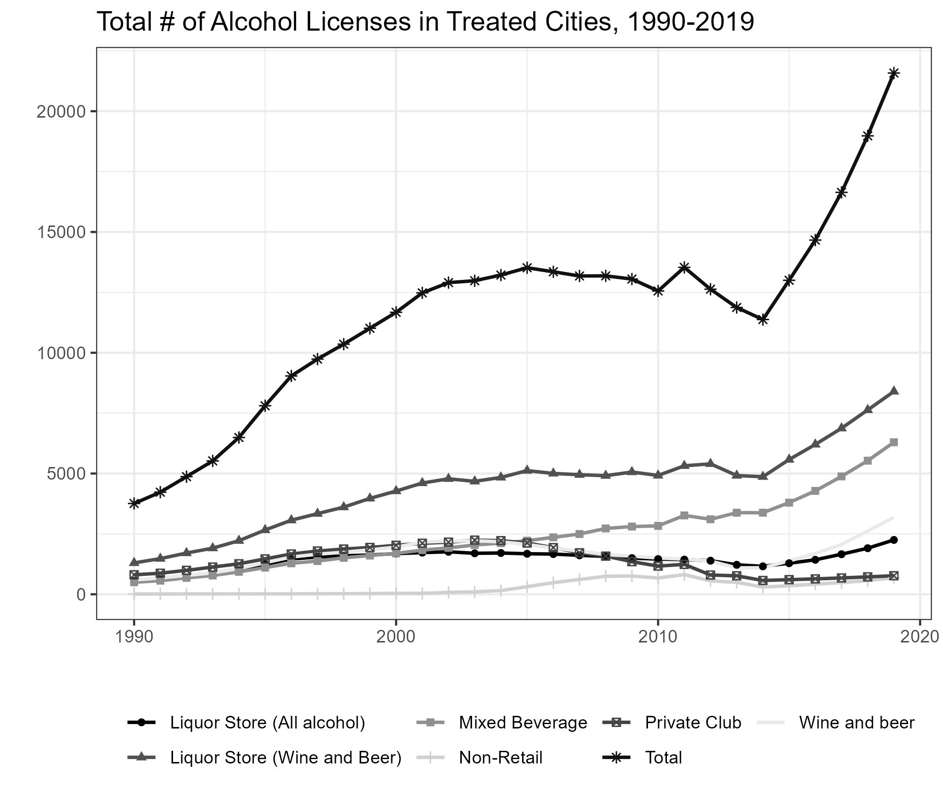
Liquor Licenses in Texas-Trends

Slide 3
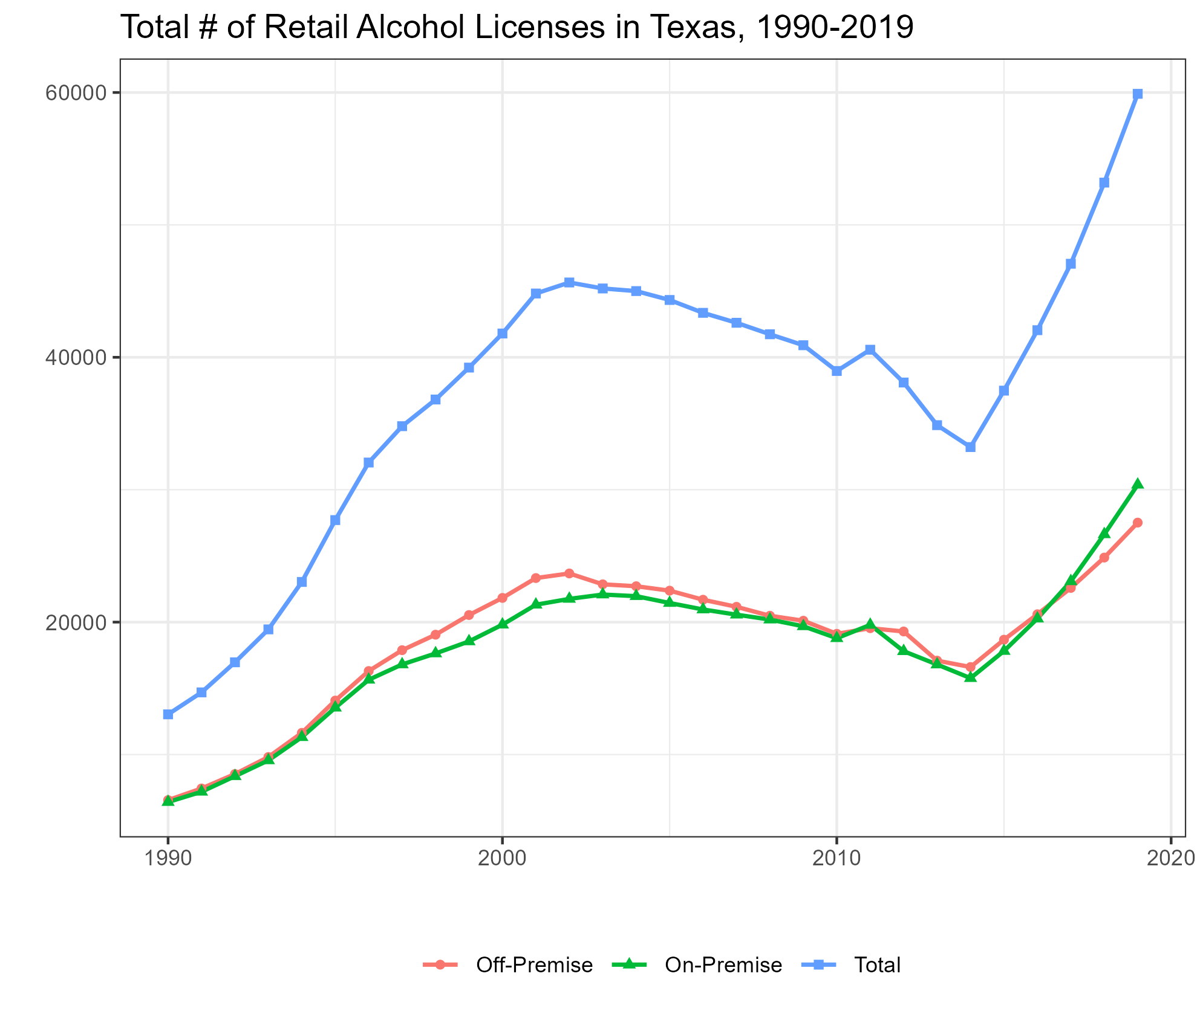
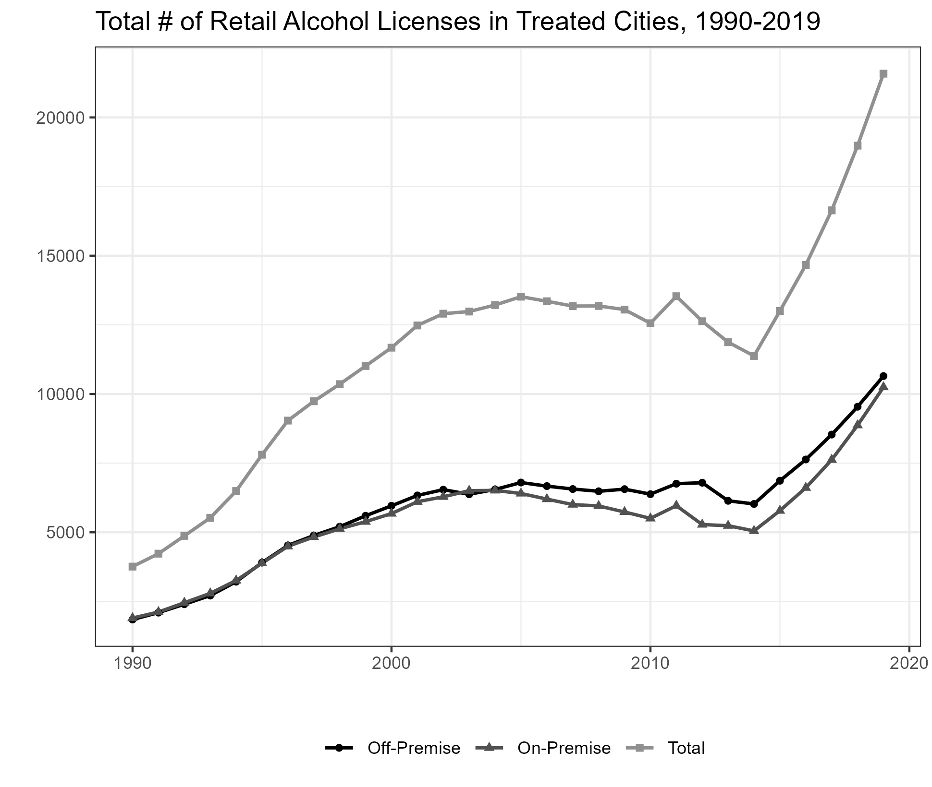
Liquor Licenses – Retail Trends

Slide 4
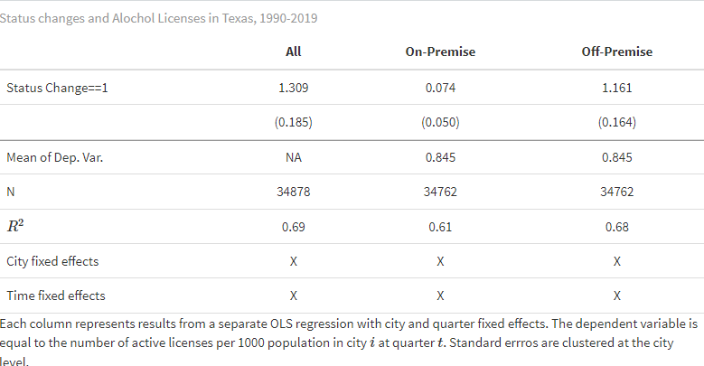

Slide 5
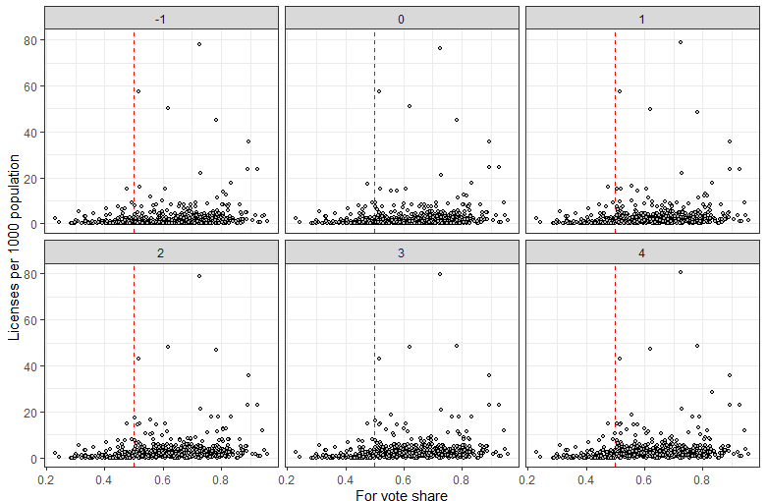
Alcohol licenses by vote share

